Slide 1
Inside Unity
Dr. Panchali Datta Choudhury
Assistant Professor
UEM Kolkata

Slide 2
Moving Rotating Scaling Game Object inside Unity
Create a new game object
Click Plus sign drop down
Select 3D object
Select a cube

Slide 3
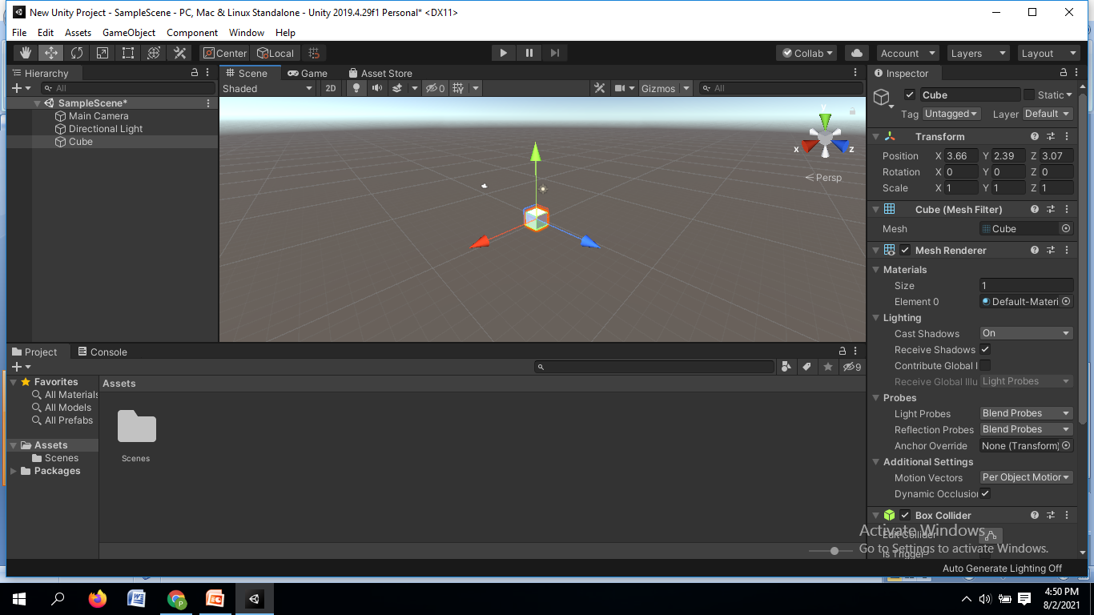
Moving

Slide 4
Red arrow for x-axis
Green arrow for y-axis
Blue arrow for z-axis
When we hover our mouse over any arrow the color of the arrow will turn yellow
Yellow means selected
Within inspector panel the values of the axis also changes

Slide 5
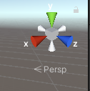
The relationship between color and axis is also found

Slide 6
Alternatively, you can change the position of the cube by changing the values of the x, y and z axis from the Inspector panel
If we place 0 in the x y and z position then you will see that the cube is at a position of 0 along x, y and z axis
Now this position of x0 y0 and z0 is referred to as universal centre position inside unity
the centre point where x, y and z axis arrows are joining is known as the pivot
x, y and z axis arrows are referred to as pivot inside unity

Slide 7
Rotating
Select the rotate tool and see how we can use to rotate the cube
So with rotate tool selected you can see spherical lines around the cube
Red spherical line will move the cube around x axis
Green spherical line will move the cube around y axis
Blue spherical line will move the cube around z axis

Slide 8
Scaling
There are two scale options
The first option is the scale tool or 3D scale tool- with this we can change the scale of the cube in 3 dimensions
The second option is rect tool option or 2D scale

Slide 9
With the scale tool selected, you can see four cubes surrounding a cube object
This red cube will increase or decrease the scale of the game object in x axis, blue cube will change the scale of the game object in z axis, and the green cube will change the scale of the game object in y axis

Slide 10
If I select the red cube and if I move it in the outer side then you will see that the x-scale of the cube is increasing
So, by default the x, y and z scale value of the cube is 1, 1, 1 and when you increase or when you move the red cube on the outer side, the scale of the cube will change

Slide 11
If we select the blue cube and move it in the outer side then you will see a change in the z-axis value, if we move it in the inner side then the z scale values shrinks
So when we use the 3D scale tool, the scale of a particular game object will increase from both the sides
Even though moving the cube on outer side, you will see that the scale of the cube is increasing from the front as well as the backside

Slide 12
If you want to increase the scale of the cube proportionally, then to do this you can select the middle grey cube, move your mouse on the outer side to increase the scale of the cube
Similarly you can select the cube and move your mouse on the inner side to decrease the scale of the cube proportionally

Slide 13
If you want to view the cube from all the six sides then press the
options key (mac) + left mouse button
or
alt key (windows) + left mouse button

Slide 14
In unity, the scale of any game object have a unit of unity units, so the cube has a x scale of --- unity units, y scale of --- unity units and z scale of ---- unity units
Measuring the scale of any game object we use scaling unit of unity units

Slide 15
Select 2D scale tool or rect tool
With this tool you can change the scale in 2 dimension at a time, i.e x-y, y-z, x-z
With the rect tool selected, we will see a rectangular border is created surrounding the cube
With this rectangular border you can change the scale of the cube along x axis and y axis

Slide 16
If I select a line and if I move the mouse in the outer side then you will see that the scale of the cube is increasing along x-axis
If I select another line and if I move the mouse in the outer side then you will see that the scale of the cube is moving along z-axis
So this is how you use the rect tool

Slide 17
Rect tool is referred to as 2D scale tool because it is used to increase or decrease the scale of 2 dimension UI elements, like button, images, canvas etc
With the rect tool only the side that is stretching increases and the opposite side of that axis does not increase

Slide 18
Depending on the view from which you are seeing the cube this rectangular borders will keep changing themselves
So depending on the requirement and the application you can switch between the 3D scale tool or 2D scale tool

Slide 19
If you want to move rotate and scale a game object altogether then to do this select move rotate or scale selected object
If I select this tool then you will see three arrows for moving the cube, three spherical lines for rotating the cube and middle cube in centre for increasing the scale of the cube proportionally

Slide 20
Game Panel in Unity
From the game panel we can view or test the output of unity project
What you see in the game panel is the same view that you will see inside your Smartphone screen or you will see inside your PC screen
What we view in the game plan is basically through the eyes of the main camera

Slide 21
So with the main camera selected if I zoom out then we will see these conical lines coming out
These conical lines are called the field of view and the game objects which are inside this field of view of the main camera are visible inside the game panel

Slide 22
Since the cube inside the field of object of the main camera so that’s why we can see the cube inside the game panel
Now if I select the main camera and if I move back, inside the camera preview we can see that size of the cube increases

Slide 23
We can view the scene output and game output simultaneously by clicking on the dropdown 2:3
If we select the main camera and keep moving it backward then inside the game panel or inside the game tab that size of the cube is shrinking
If we move it in front then the size of the cube is increasing

Slide 24
If we select the main camera and move it ahead of the cube then you will see that since the cube is behind the main camera and since the cube is not inside the field of view of the main camera so that’s why the cube is not visible inside the game panel

Slide 25
So only the GameObjects which are inside the field of view of the main camera will be visible inside the game panel
We cannot edit game object inside the game panel, i.e. we cannot move, rotate or scale GameObjects from inside the game panel, we can only view the output of a project inside the game panel

Slide 26
Moving, rotating and scaling a game object is possible only inside the scene panel
From inside the game panel if we try to select the cube, if we click on it then we can see that nothing is happening because we are only allowed to view the output of a project

Slide 27
Switch back layout to default
For advance editing select 4 split option from dropdown
There are four different views
All are same go right click any of the tab and add tab to select game panel view
After this click on scene tab and close tab
Lock item means this scene is locked to this particular view
When unlocked it can be moved in 360 degree format

Slide 28
If we select the main camera you can see the icon of the main camera, if you select the directional light you can see the icon for directional light
The directional light and main camera are invisible components and inside the scene panel you can only see the icons but inside game panel it cannot see directional light or main camera icons
These are referred to as gizmos

Slide 29
Depending on the project requirement you can enlarge or you can decrease the size of these gizmos
For reducing the size of these gizmos click the dropdown beside gizmos icon and you can increase or decrease the size of the slider

Slide 30
Physics components
We will now see how to add physics components to Game Objects and after this we will test the application output inside the play mode
Inside scene panel we will change shape of this cube so that it appears as a flat surface
Before that we have to reset the position, rotation and scale of the cube to its original dimension

Slide 31
Change scale x value to 7, z value to 7 and y value to 0.2
Change position x value to 0, y value to 1 and z value to -10
Cube will appear as a flat surface, if we go inside the game panel we can see the cube
Adjust main camera to view the flat surface cube in the game panel

Slide 32
Add another 3D object sphere
Change the position of the sphere otherwise it will be placed on the cube
Now this sphere is not falling on the flat surface, although in real world any object with mass will fall
So add physics component to this sphere, called rigid component

Slide 33
If the gravity is checked it should fall
Now go to the game panel and click the play button
Button will turn blue, it means it is in play mode, button turning grey means it is outside the play mode
Don’t make any changes in scene panel while play mode is on otherwise it wont be saved

Slide 34
The pause button will pause the application
Step button will move the application to next frame

Slide 35
How to increase lighting inside scene panel
Go to windows, then rendering and next lighting setting options
Click on generate lighting button

Slide 36
Adding colors to Game Object
For adding colors to the cube and the sphere game object will create a material component
Before creating the material component, create a new folder by the name of materials and will store all our materials inside that folder

Slide 37
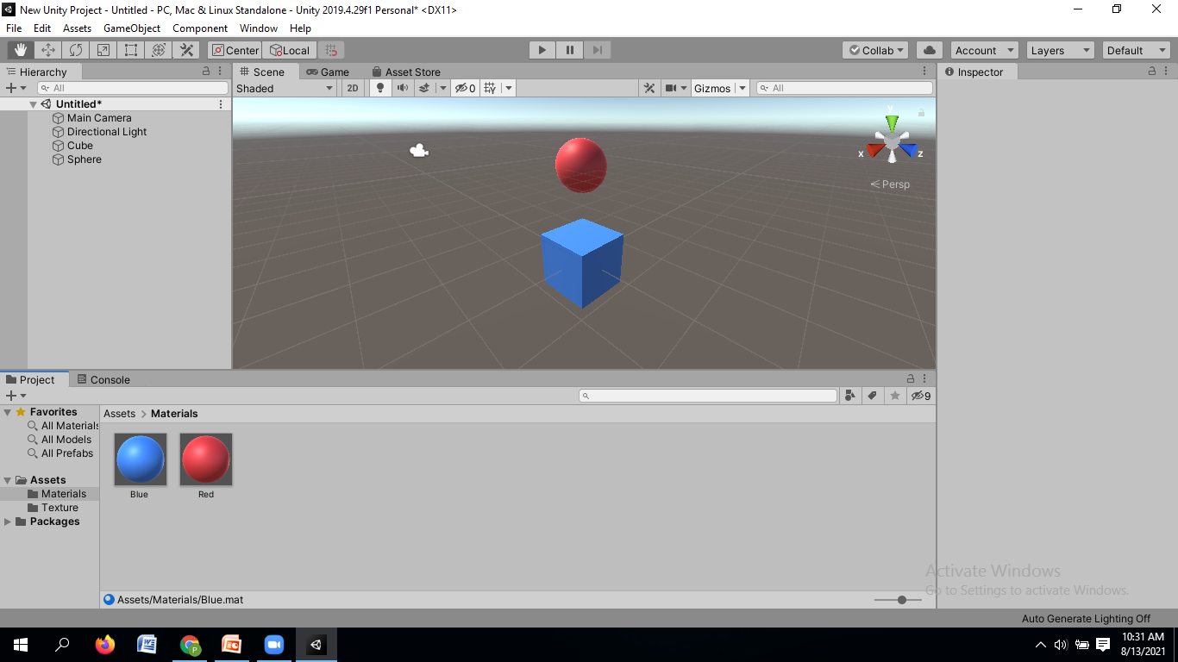

Slide 38
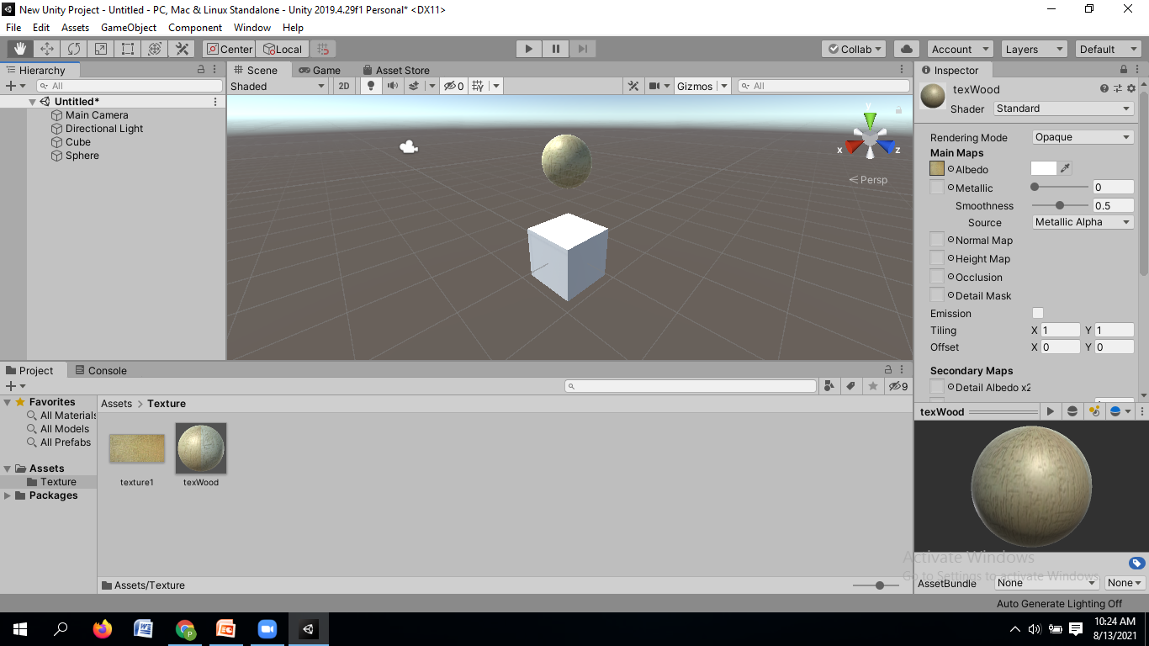
Adding textures to Game Object

Slide 39
Parent Child Game objects
If we place one Game object inside another Game object then the outer Game object is called the Parent Game object and the inner Game object is called the child Game object
Cube
Sphere1
Sphere2

Slide 40
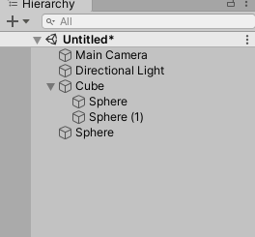

Slide 41
With cube game object selected if we move the cube you will notice that the sphere game object is also moving along with it
This is happening because the sphere game object is now child of the cube game object
If we select the sphere and move it then you will see that moving the sphere game object has no effect on its parent game object i.e. the cube

Slide 42
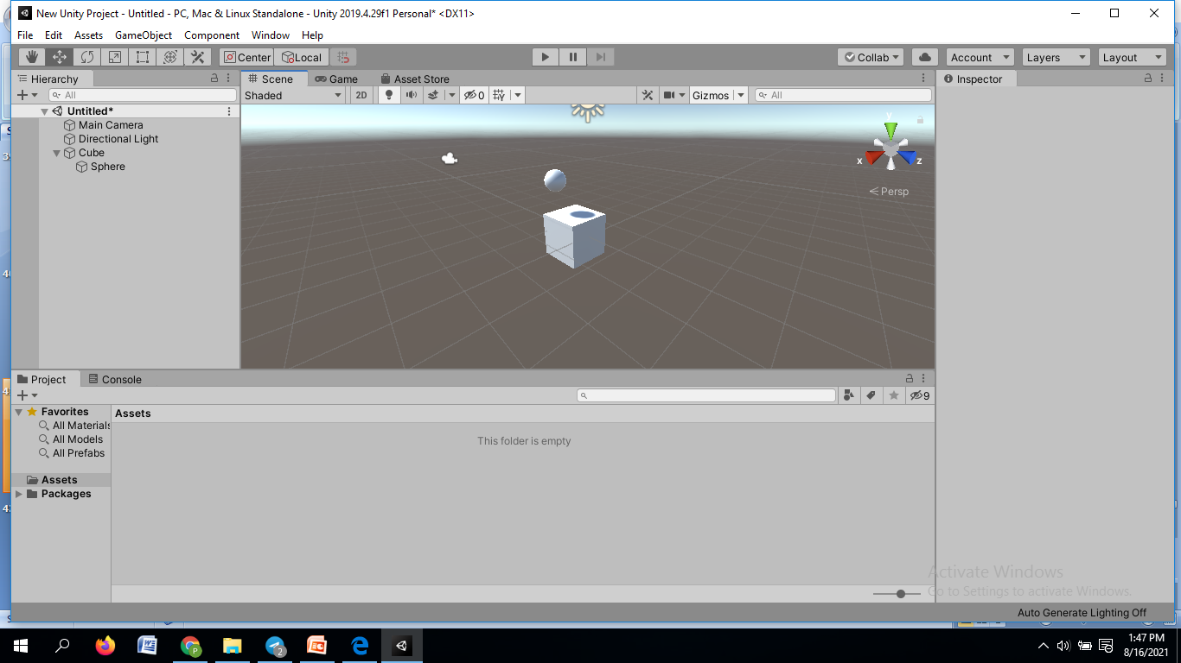

Slide 43
We can also place multiple game object of similar type inside a single game object
Click on the plus sign drop down and click on create empty button, so we will create an empty game object
We will use this empty game object as a holder to hold the cube and the sphere game object
Rename this game object as cubeSphereHolder

Slide 44
Select the cube game object and move it inside the cubeSphereHolder
Now, cube game object is a child of cubeSphereHolder and sphere game object is a child of the cube game object
Alternatively, we can make the cube and the sphere directly the child of cubeSphereHolder
Move sphere out of this cube
To unchild drag it out, it is an individual child
Now drag it to cubeSphereHolder

Slide 45
Pivot/centre tool and the local/global tool
In unity, the pivot/centre tool is used for viewing the actual pivot position of the parent game object
or
it is used for viewing the centre pivot position of the parent game object with respect to the different child game objects which are present inside the parent

Slide 46
With pivot/centre tool set to pivot if I click on the cubeSphereHolder game object then the pivot of this cubeSphereHolder will appear at its original position (0, 0, 0)
If clicked on pivot/centre tool and set it to centre we will see that the pivot of this cubeSphereHolder is now in the middle of the sphere and the cube game object

Slide 47
This happens because when we change the pivot/centre option to centre so during the time unity takes the position input of the cube and sphere
After taking the input of the two child game object, it positions the parent (cubeSphereHolder) in centre of the two child game objects

Slide 48
If we add another game object by duplicating the sphere ( for duplicating ctl + d -- windows user, command + d -----mac users)
After duplicating the sphere if we move the sphere on the right hand side and if click on the cubeSphereHolder then we will see that the pivot position is changed
Now there are three child game objects inside the cubeSphereHolder so unity takes input from these three child game objects and it positions the pivot of the cubeSphereHolder accordingly

Slide 49
Local/Global Tool
Using local/global tool we can position and rotate game objects locally and globally
Click on the Local/Global Tool set it to local
With local option set, if we select the cube game object next if I select the rotate tool and rotate the cube then we find spherical lines surrounding cube are also being rotated
If we select the position tool, then we will see that the x, y and z axis of this cube are also rotated along the z-axis

Slide 50
If we select the y position arrow and move the cube then the cube moves is a particular direction
Similarly if we sect the x axis, cube moves in another direction

Slide 51
If we select the global tool, then regardless of the rotation in which the cube is facing, the x, y and z axis will point towards the global position
If we move the position of the cube it will move along global axis
Local/global tool is used to move the position of game objects along global axis or local axis after rotating the game object

Slide 52
THANK YOU

